Slide 1
Real Options and Investment Mode: Evidence from Corporate Venture Capital and Acquisition
Tony Tong and Yong Li
Organization Science (2011)
Slides by Jingya You
Presented by Youngsir Rha

Slide 2
INTRODUCTION
Corporate venture capital (CVC) and acquisition are two alternative modes for external business development and corporate growth.
Prior research has analyzed why firms make acquisitions and when acquisitions are value creating.
Research has also examined why firms undertake CVC investments and when such investments create value for the investing firms.
Gap: much less work has been done to examine firms’ CVC investments in comparison with acquisitions.
RQ: when do firms prefer to undertake CVC investments versus acquisitions?
Real options theory is fitting for this study.
Firms making CVC investments often confront substantial uncertainty.
CVC investments are embedded with several real options, whose value is enhanced under uncertainty.

Slide 3
THEORETICAL BACKGROUND
A real options view of CVC investments
CVC investment is often fraught with uncertainty regarding the viability of the business model or market demand, and the return of the investment.
By staging their financing, CVC investors can offer several types of real options to deal with uncertainty. Specifically, after the initial investment, the CVC firm obtains the option to expand, the option to abandon, and the option to defer.
A real options view of acquisitions
Compared to CVC investments, acquisitions have limited real options and provide less flexibility in general.
Acquisitions represent high commitment rather than flexibility 🡪 provide little deferral option
Acquisitions are typically one-time deals 🡪 provide few sequential investment possibilities and expansion option
It is more difficult to acquire and then divest a company than to liquidate a minority equity stake in a CVC investment project less likely to exercise an abandonment option

Slide 4
HYPOTHESES (Main Effect)
Irreversibility (H2)
Uncertainty
+
CVC (1)
vs
Acquisition (0)
+
(H1)
-
Growth opportunities (H3)
Competition (H4)
Firms making CVC investments or acquisitions usually confront various (exogenous) uncertainties. Uncertainty highlights the importance of maintaining flexibility to adjust investment decisions over time as information is revealed and uncertainties are resolved.
Compared to CVC investments, acquisitions give the firm less flexibility to adjust or reverse its actions.
H1: The greater the level of uncertainty, the more CVC is preferred over acquisition.

Slide 5
HYPOTHESES (Contingent Effects)
Irreversibility of investments
Investments are irreversible when their resale value is less than their cost.
As irreversibility increases, investment decisions will become more sensitive to conditions of uncertainty. As a result, the value of the real options embedded in CVC investments will be enhanced by irreversibility and uncertainty jointly.
H2: The greater the level of irreversibility, the stronger the positive relationship between uncertainty and the preference for CVC over acquisition.
Growth opportunities
Delaying or staging investments in the presence of growth opportunities may incur opportunity costs of waiting. The value of real options embedded in CVC investments will be partially offset by the growth opportunities that are present.
H3: The greater the level of growth opportunities, the weaker the positive relationship between uncertainty and the preference for CVC over acquisition.
Competition
Growth opportunities typically are not exclusively owned by a firm, but rather are shared and accessible by industry competitors.
When competitors have access to nonproprietary opportunities, the strategic value of the firm’s commitment may outweigh the flexibility value of deferring or staging investment.
H4: The greater the level of competition, the weaker the positive relationship between uncertainty and the preference for CVC over acquisition.

Slide 6
METHODS
Sample
The investing firms are public firms included in the Compustat database during the time period of 2003–2005
The investees and the targets are private companies based in the U.S.
A total of 2775 deals: 546 CVC investment deals & 2229 acquisition deals
Measurement
DV: a dummy variable (1 if an investment is a CVC; 0 otherwise)
IV: exogenous uncertainty – the volatility of industry stock market indices
Moderators
Irreversibility – the median value of the ratio of intangible assets to total assets for all firms in the industry
Growth opportunities – the median market-to-book ratio of the investee’s industry
Competition – one-minus-industry concentration ratio
Controls
Investing firm: firm size, R&D intensity, firm’s profitability, CVC to acquisition experience
Investee’s industry: industry profitability, industry R&D intensity, IP regime
The investor-investee dyadic level: interindustry investment, different state
Investee firm: firm age, firm size
Two-year dummies
Supplement quantitative analyses with field interviews

Slide 7
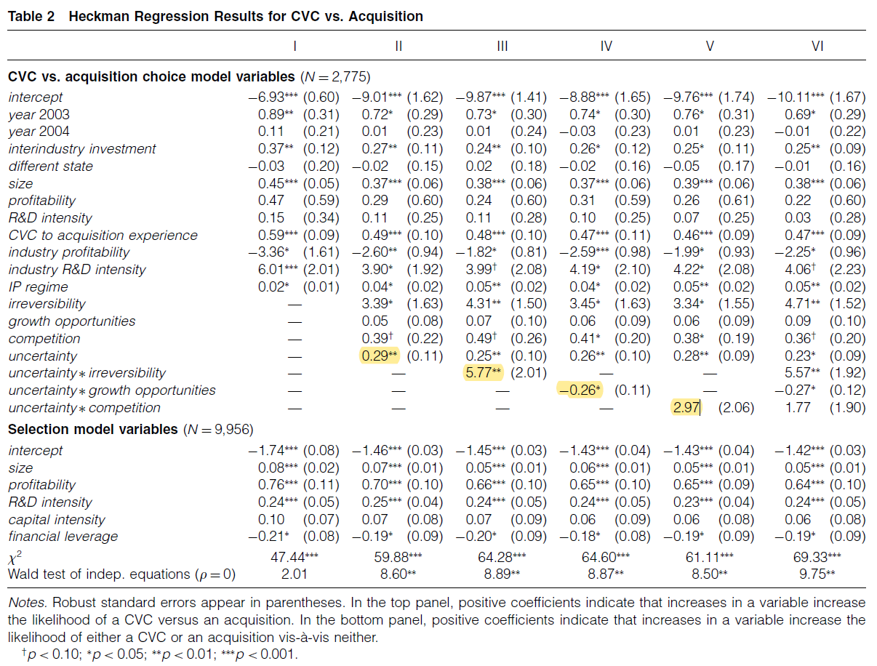
RESULTS
H1
H2
H3
H4

Slide 8
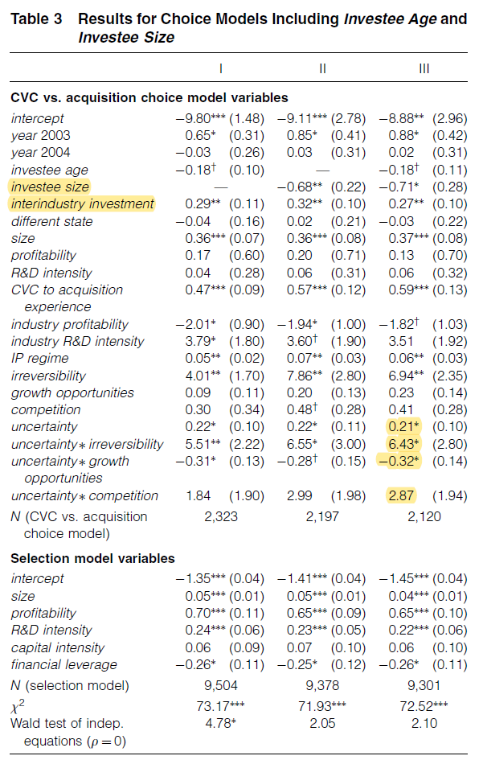
RESULTS
H1, H2, H3
H4

Slide 9
CONCLUSIONS
When an investment is surrounded by high levels of market uncertainty, maintaining flexibility becomes more important, and firms are more likely to undertake CVC investments rather than acquisitions.
Investment irreversibility will further increase firms’ propensity toward CVC, whereas growth opportunities facing the investment will weaken the preference for CVC under uncertainty.
Contributions
It complements prior research by focusing on the antecedents of the choice between CVC and acquisition.
By taking a comparative approach, it highlights CVC as another important investment mode, which has been neglected in previous research comparing acquisitions with other corporate investment strategies.
By using a comparative lens, it complements the research on the conditions affecting firms’ choice between CVC investments and acquisitions.

